Slide 1
Algoim Mimic
Generating data (Algoim inputs via matlab)
FNN(Training the model)
Run Inference on the model
Pre Processing (filtering only monotonics functions )
Sorting + Weight scalling

Slide 2
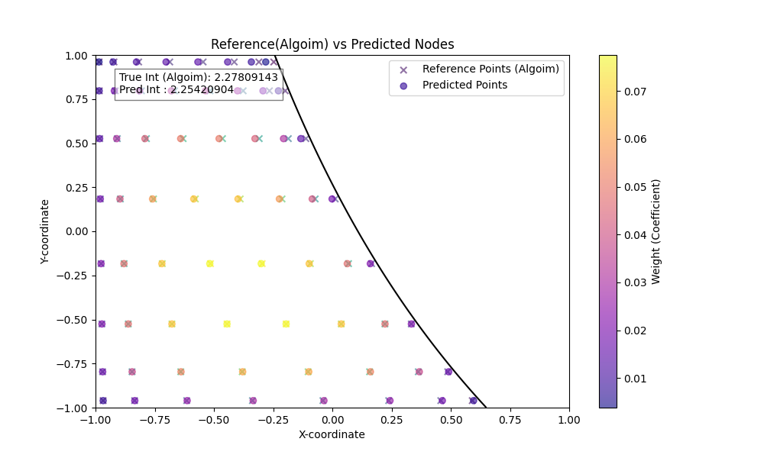
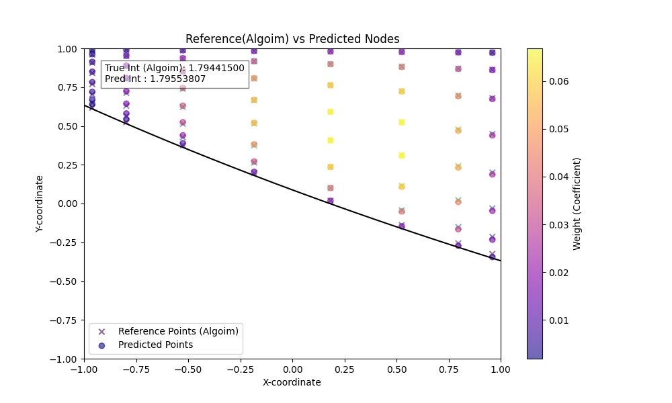
Resutls – Model output Vs Algoim
Overall MAE: 2.3697e-02
Overall MSE: 8.2484e-04
Mean Relative Error: 4.87%
Median Relative Error: 1.34%

Slide 3
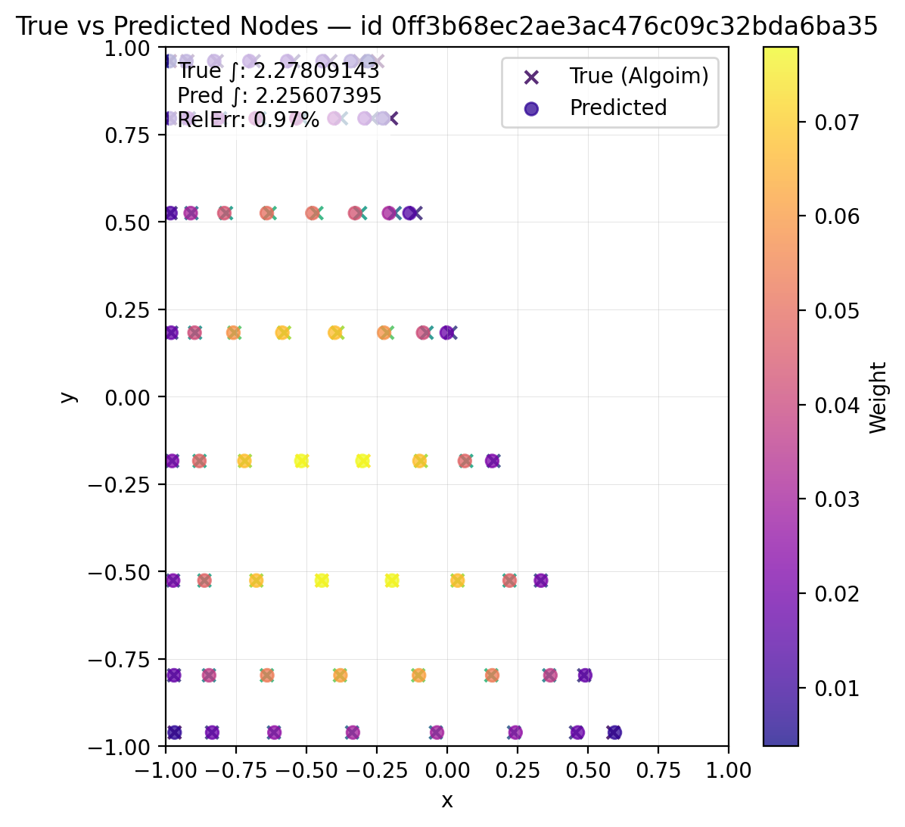
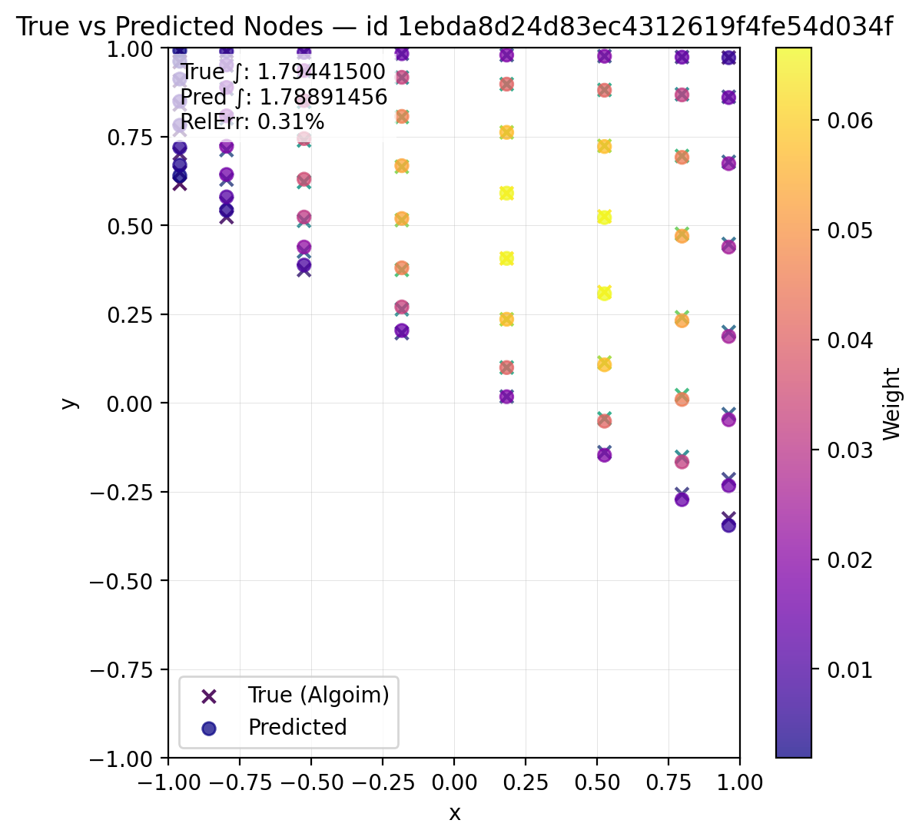
Results – Postprocessing(scalled) Vs Algoim
Overall MAE: 2.660267e-02
Overall MSE: 1.001541e-03
Mean Relative Error: 6.3144%
Median Relative Error: 1.3023%

Slide 4
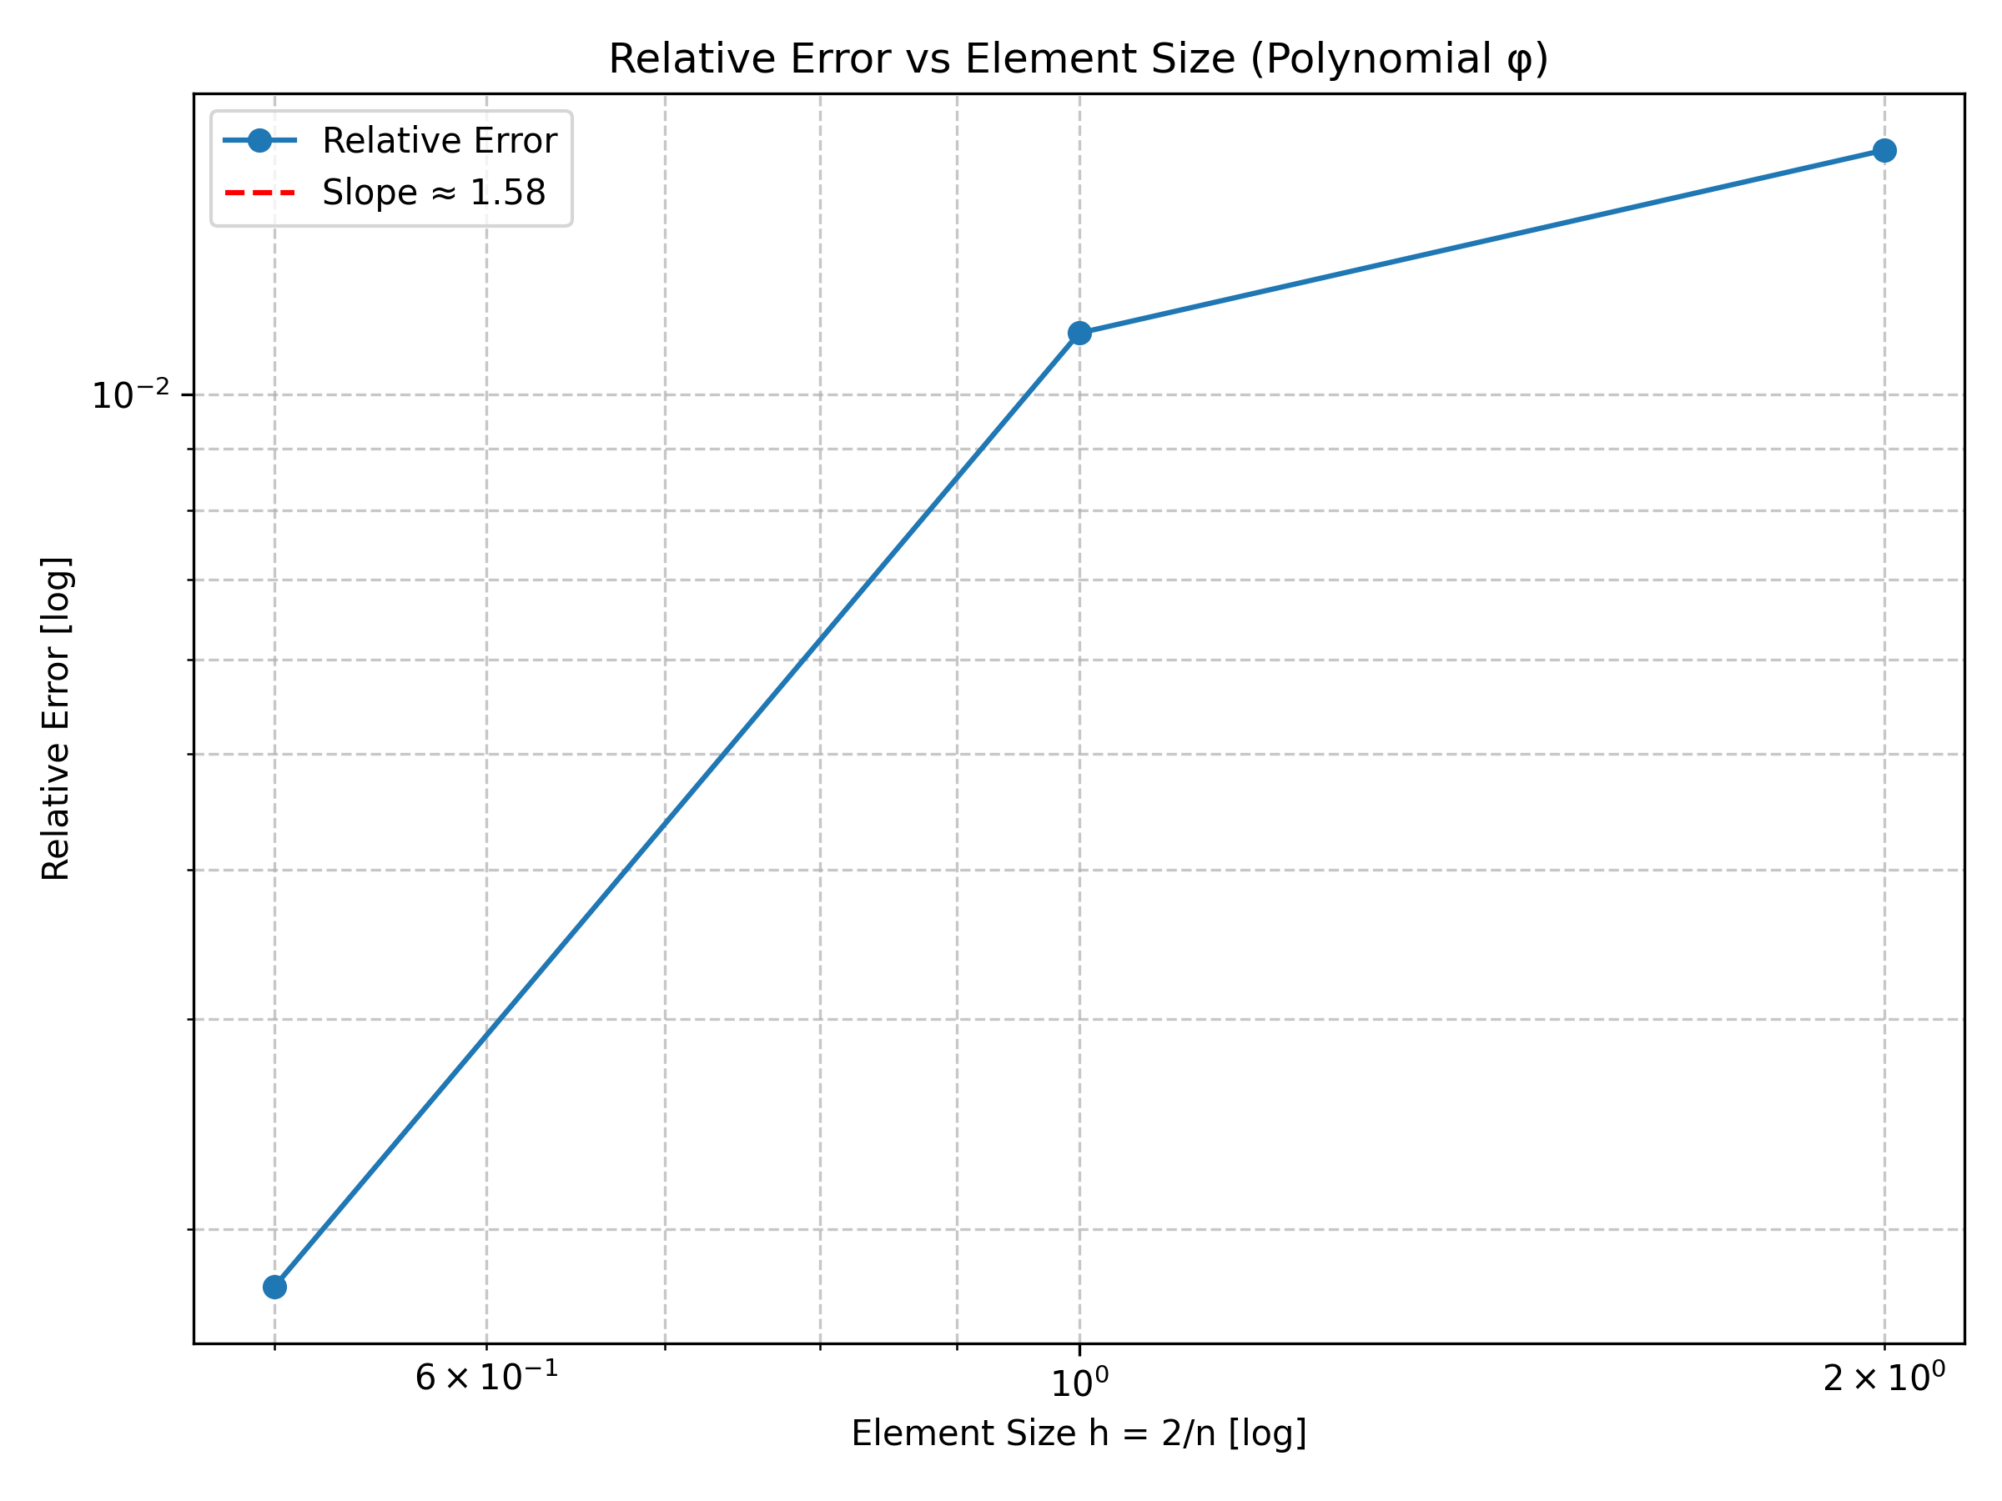
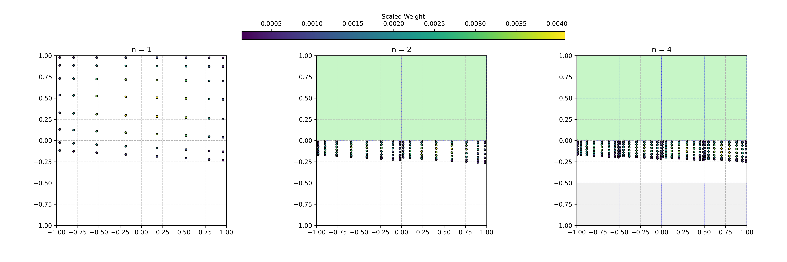
Convergence plot
convergence slope ≈ 1.580

Slide 5
The suspected errors and solutions…
Model training with insufficient data set – Train model with larger data set
Weight scalling not effective (maybe we look at the logic again)
Possibility to use the weights from model traing ???

